Slide 1
Chapter XI
Euler Transforms and Quaternions
All class materials including this PowerPoint file are available at
https://github.com/medialab-ku/openGLESbook

Slide 2
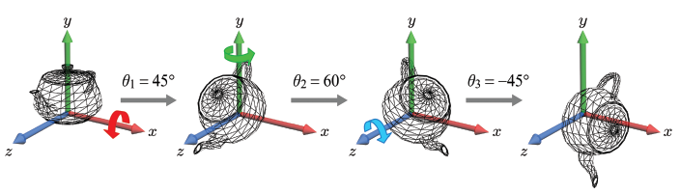
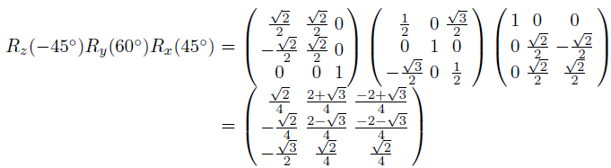
Euler Transforms
When we successively rotate an object about the principal axes, the object acquires an arbitrary orientation. This method of determining an object’s orientation is called Euler transform, and the rotations angles, (θ₁,θ₂,θ₃), are called the Euler angles.
Concatenating three matrices produces a single matrix defining an arbitrary orientation.
11-<number>

Slide 3
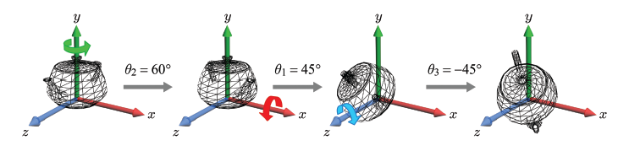
Euler Transforms (cont’d)
The rotation axes are not necessarily taken in the order of x, y, and z. Shown below is the order of y, x, and z. Observe that the teapot has a different orientation from the previous one.
11-<number>

Slide 4


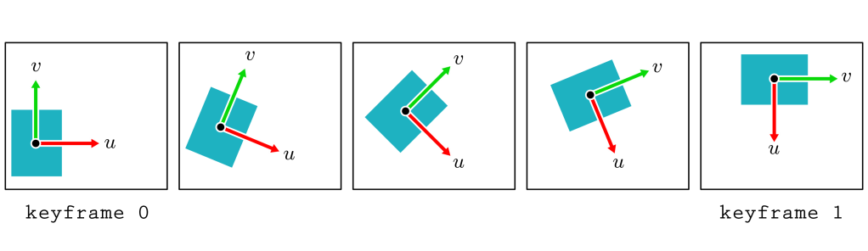
Keyframe Animation in 2D
In the traditional hand-drawn cartoon animation, the senior key artist would draw the keyframes, and the junior artist would fill the in-between frames.
For a 30-fps computer animation, for example, much fewer than 30 frames are defined per second. They are the keyframes. In real-time computer animation, the in-between frames are automatically filled at run time.
The key data are assigned to the keyframes, and they are interpolated to generate the in-between frames.
In the example, the center position p and orientation angle θ are interpolated.
11-<number>

Slide 5
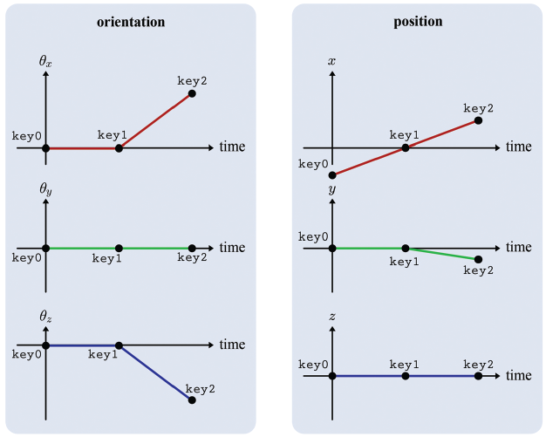
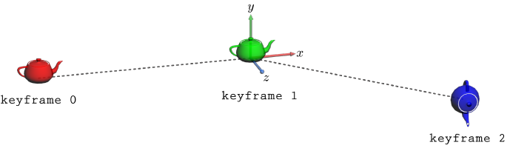
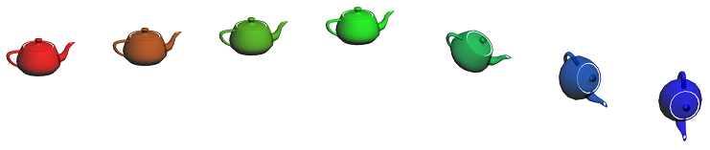
Keyframe Animation in 3D
Keyframe animation in 3D: Seven teapot instances are defined by sampling the graphs seven times.
11-<number>

Slide 6
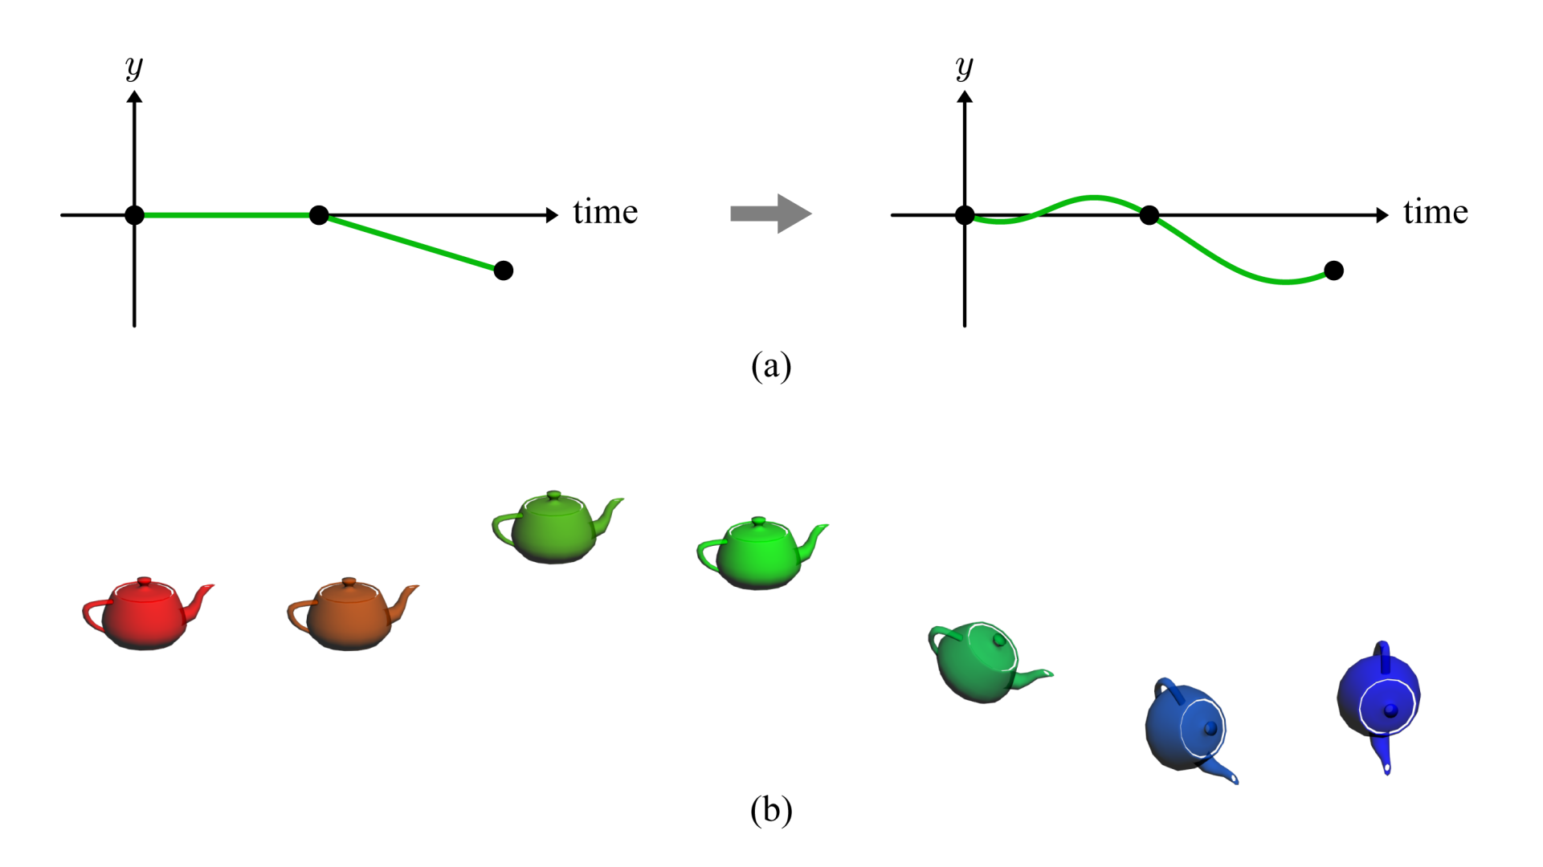
Keyframe Animation in 3D (cont’d)
Smoother animation may often be obtained using a higher-order interpolation.
11-<number>

Slide 7
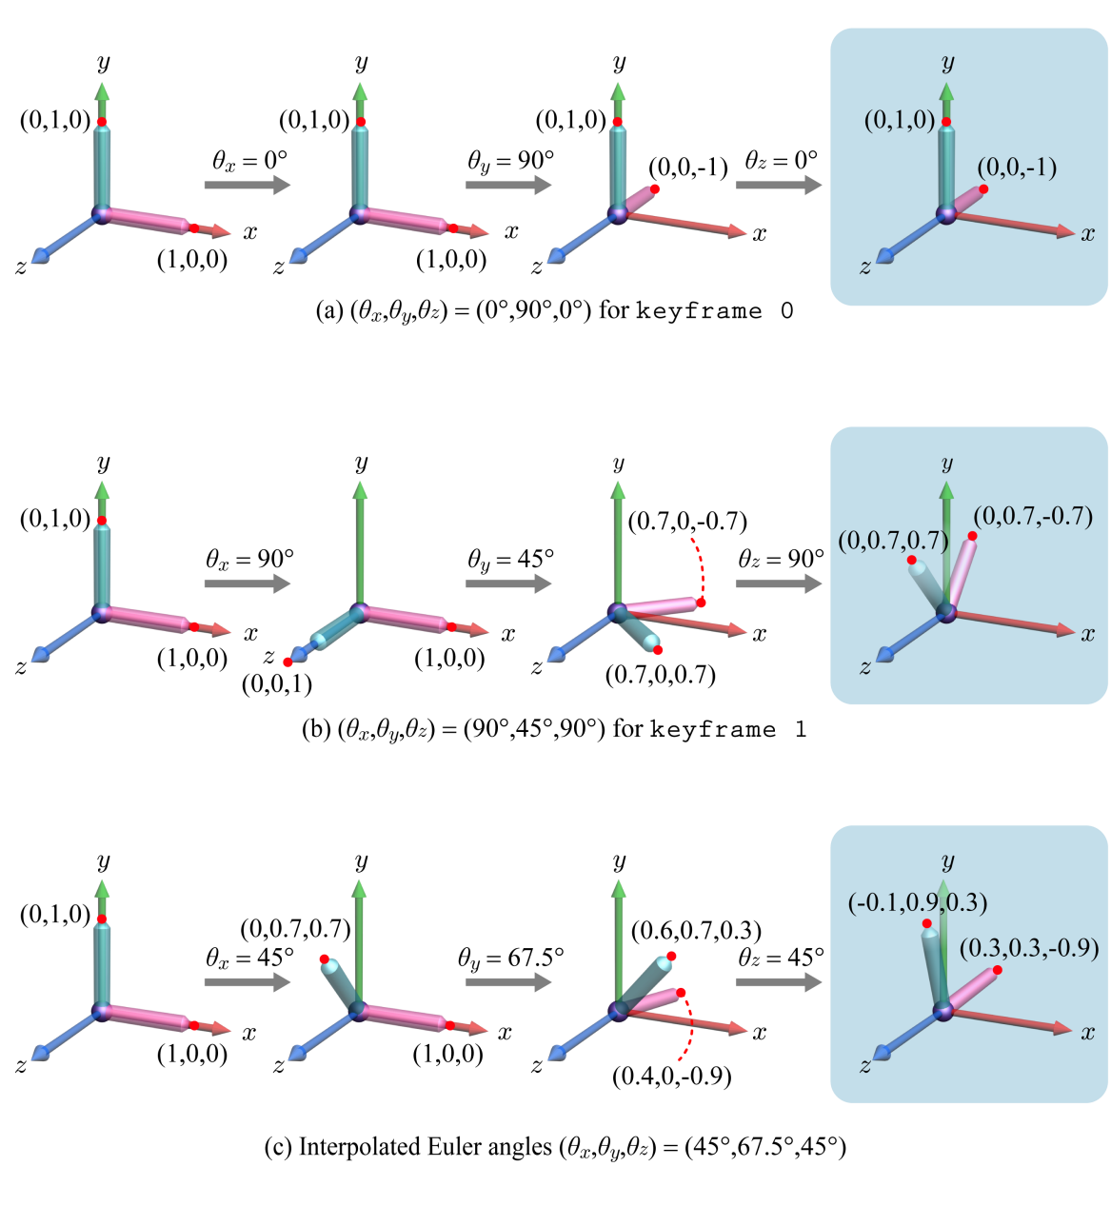
A Problem of Euler Angles
Euler angles are not always correctly interpolated and so are not suitable for keyframe animation
11-<number>

Slide 8


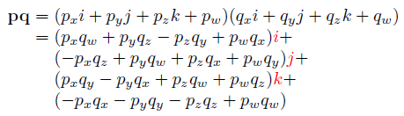


Quaternion
A quaternion is an extended complex number.
Conjugate
It is easy to show that (pq)*=q*p*.
Magnitude: If the magnitude of a quaternion is 1, it’s called a unit quaternion.
11-<number>

Slide 9

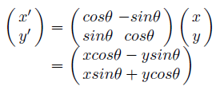

2D Rotation through Complex Numbers
Recall 2D rotation
Let us represent (x,y) by a complex number x+yi, and denote it by p.
Given the rotation angle θ, let us consider a unit-length complex number, cosθ+sinθi. We denote it by q. Then, we have the following:
Surprisingly, the real and imaginary parts of pq represent the rotated coordinates.
11-<number>

Slide 10
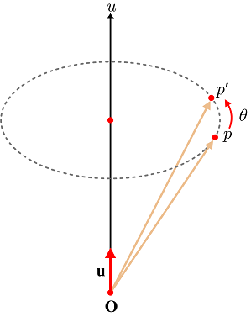


3D Rotation through Quaternions
As extended complex numbers, quaternions can be used to describe 3D rotation.
Consider rotating a 3D vector p about an axis u by an angle θ. Represent both “the vector to be rotated” and “the rotation” in quaternions.
  Define a quaternion p using p.
  Define a unit quaternion q using
  u and θ. (The axis u is divided by
  its length to make a unit vector u.)
  Compute qpq*. Then, its imaginary
  part represents the rotated vector.
See the textbook for proof.
11-<number>

Slide 11
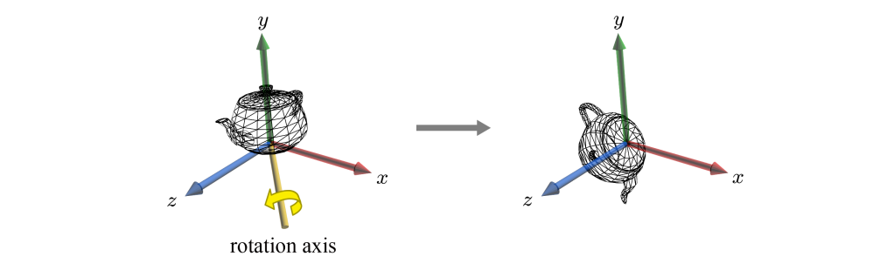

3D Rotation through Quaternions (cont’d)
Quaternions enable rotations about arbitrary axes.
11-<number>

Slide 12

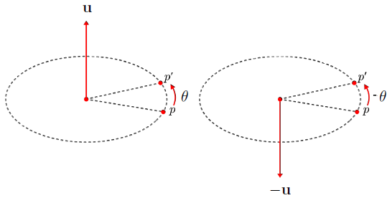
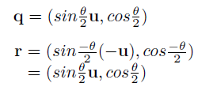
3D Rotation through Quaternions (cont’d)
Let p' denote qpq*. It represents the rotated vector p'. Consider rotating p' by another quaternion r. The combined rotation is represented in rq.
“Rotation about u by θ” is identical to “rotation about –u by –θ.”
11-<number>

Slide 13

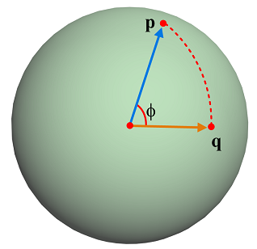
Interpolation of Quaternions
Consider two unit quaternions, p and q, which represent rotations. They can be interpolated using parameter t in the range of [0,1]:
This is called spherical linear interpolation (slerp).
See the textbook for proof.
11-<number>

Slide 14
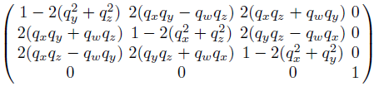
Quaternion and Matrix
A quaternion q representing a rotation can be converted into a matrix form. If q = (q_{x},q_{y},q_{z},q_{w}), the rotation matrix is defined as follows:
See the textbook for proof.
Conversely, given a rotation matrix, we can compute its quaternion. It requires us to extract {q_{x},q_{y},q_{z},q_{w}} given the above matrix.
  Compute the sum of all diagonal elements.
  So, we obtain q_{w}.
  Subtract m₁₂ from m₂₁ of the above matrix.
  As we know q_{w}, we can compute q_{z}. Similarly, we can compute q_{x} and q_{y}.
11-<number>

Slide 15
Quaternion - Summary
Summary
  An arbitrary 3D rotation is represented in a quaternion as well as in Euler transform.
  Quaternions are correctly interpolated through slerp.
  A quaternion can be converted into a rotation matrix.
Given quaternions for the keyframes,
  spherically interpolate them for the in-between frames, and
  convert each interpolated quaternion into a rotation matrix.
11-<number>

